Slide 1
Paper Drums
Omar Waheed
Rehan Rasool

Slide 2
Background
Musical instruments are expensive e.g. drum kits
Use simple colored papers to interact with computers
Use Computer Vision to build a system that plays sounds

Slide 3
Stage 1: analysis
Analyze how a drum kit works
How can we make a paper model of it
Find a way to use human interaction through computer vision to play sounds

Slide 4
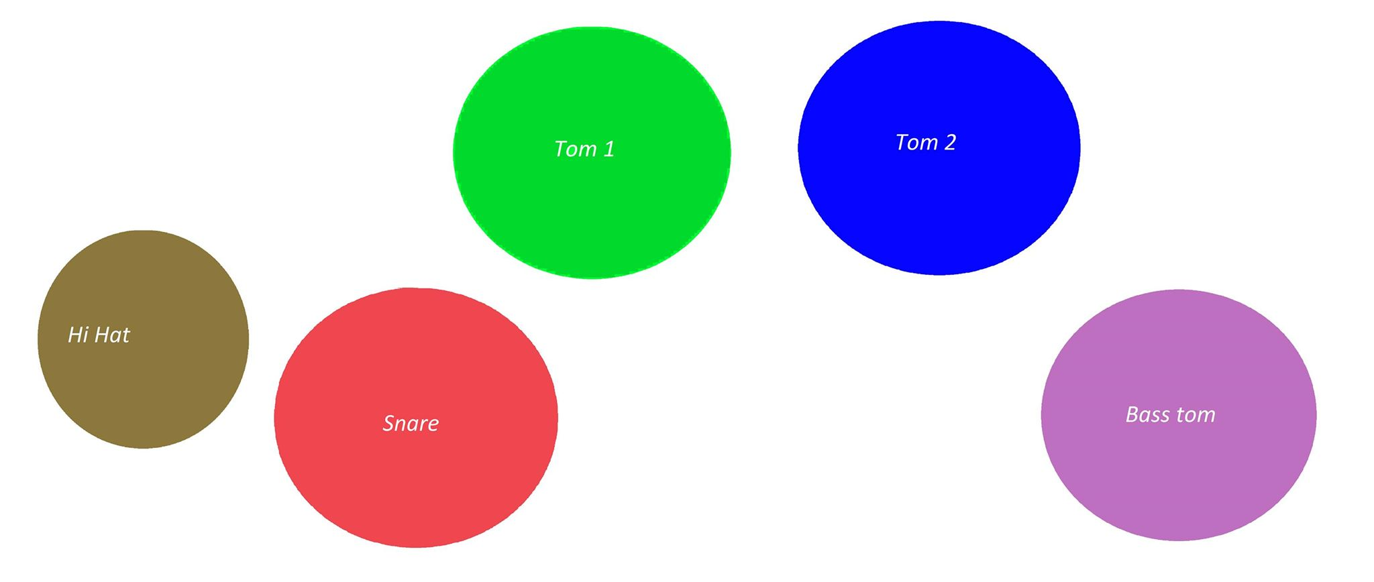

Slide 5
Stage 2: approach
Detect initial colored circles on the paper
Save the initial colored state for all circles
Run the program and wait for a circle to be covered
If a circle is covered by a certain threshold, play its corresponding sound
To only play a sound when user touches the circle, add another camera with similar logic

Slide 6
PROBLEMS ENCOUNTERED
Colored tracking under different lighting conditions inaccurate
Changed the algorithm to use HSV space instead of RGB
Pick a ROI from the picture
reduce computations significantly
ignore any similar colors in environment
Built-in sound library was primitive
Used irrKlang sound library
Speed up sound processing
Overlapping of sound possible
User Interface too complicated
Used open source project to merge multiple screen outputs into one

Slide 7
Step 3: testing
Ran tests to ensure all circle detection is working correctly
Ran tests to ensure threshold logic is working
Ran tests to ensure both camera’s output coincides for same circles
Used 5 students to test the program

Slide 8
Step 4: evaluation
Initial development stage
Many improvements can be made to achieve “realistic” outcome
Motion detection
Better colored object tracking algorithm
Further optimize the solution

Slide 9
future
Make improvements
Make a web application
Create other projects that use this approach: colored objects on a paper
Paper Piano etc.
Paper Games
etc.

Slide 10
demo

Slide 11
questions

